Slide 2
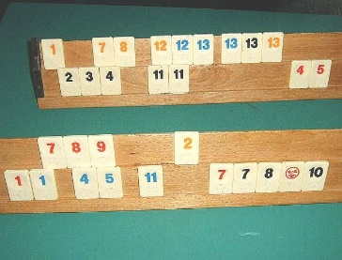
10.1 Okey - Rummykub
Objectives
Participants already can count from 1 to 13.
You can differentiate colours.
The game Rummikub is similar to the card game Rummy.
You learn to combine 13 numbers from 1 to 13 in 4 different colours.
One learns to observe and apply mathematical and game rules.
Tools, Materials and Organisation
Always 4 players play in a group together.
Each player gets 14 tiles, the player, who will begin, gets 15 tiles.
You can buy Rummikub in an shop or you construct your tiles on your own (see the copying template).

Slide 3
10.1 Okey - Rummykub
Description of the Lesson
First part of the lesson (10 minutes)
Explain the game Rummikub.
Use for this explanation the work sheet for students.
Each single student gets his own work sheet.
Edit the worksheet together.
Second part of the lesson (30 minutes)
Sit together in groups with 4 participants.
Each participant gets 14 tiles, the player, who will begin, get 15 tiles.
Play according to the rules. A whole game can sometimes last longer than 30 minutes.
Useful Hints
Rummikub in the Internet:
http://rummikub.spiel-jetzt.org/
https://en.wikipedia.org/wiki/Rummikub
https://www.youtube.com/watch?v=yLsXoE3si7E
https://www.youtube.com/watch?v=yrOYpkxL3G0

Slide 4
10.1 Okey - Rummykub
1
red
1
black
1
blue
Condition 1: Same numbers, different colours, 3 or 4 stones
6
red
7
black
8
blue
9
blue
Condition 2: Following numbers, same colour, 3 or more stones

